Slide 1
AutoCAD P&ID .NET API
AutoCAD Plant 3D .NET API
Autodesk Developer Network

Slide 2
Autodesk Developer Network
Marketing Support
Contact with sales, resellers
Product licenses for development
All products with supported APIs
Current and previous versions
Beta versions
Technical Support
Developer Technical Services
www.autodesk.com/joinadn

Slide 3
Autodesk Developer Network
Access to almost all Autodesk software and SDK’s
Including early access to Beta software
Unlimited technical support
Product direction through conferences (DevDays)
Marketing benefits
www.autodesk.com/joinadn

Slide 4
Developer Technical Services
Worldwide Workgroup
Over 25 Specialists World Wide
Virtually 24 hour support, 5 days a week
Americas Team
US (CA, AZ, WA), Canada, Brazil
European Team
Switzerland, United Kingdom, France, Czech Republic, Russia
APac Team
China, Japan, India

Slide 5
Getting Acquainted
Who Are You?
Name, Company
Experience
Programing, AutoCAD, Civil 3D
Goals with this class
Developing product, automate internal work

Slide 6
Course Objective
It is to understand:
The fundamentals of P&ID and Plant 3D APIs
How to teach yourself the P&ID and Plant 3D APIs
Where to get help with afterwards
What it is not:
Teach you C#, VB, .NET
Give you complete coverage of all API functions

Slide 7
Before we start… some links
Civil 3D Developer Center General information and resources http://usa.autodesk.com/adsk/servlet/index?siteID=123112&id=15460551
ADN DevBlog for Plant 3D Post focused on specific features http://adndevblog.typepad.com/autocad/plant3d/

Slide 8
Getting Support
ADN DevHelp Support http://adn.autodesk.com/
Forum support P&ID: http://forums.autodesk.com/t5/autocad-p-id-general-discussion/bd-p/245 Plant 3D: http://forums.autodesk.com/t5/autocad-plant-3d-general/bd-p/371

Slide 9
Contents
Overview
Setting up Plant SDK
Creating an AutoCAD plug-in
Project API
P&ID entities
DataLinks manager
Piping entities

Slide 10
Training Material
Presentation
Labs
Step-by-step (.docx)
Sample code
Notes:
"Please, copy the materials to your disk C:"

Slide 11
Plant SDK Supported Programming Languages
.NET is preferable (VB or C#)
Unmanaged C++:
Is supported for Entity (AcDb) classes
For the Project Manager and Data Manager APIs - is supported via C++ Interop to access the .NET classes.
VBA, AutoLISP and COM are NOT supported
Notes:
"Managed" means ".NET"
"Unmanaged" means "not .NET"

Slide 12
The IDE - Visual Studio
Professional and Free editions
Versions for .NET development
For AutoCAD 2010/11 Visual Studio 2008 SP1 (.NET 3.5)
For AutoCAD 2012/13/14 Visual Studio 2010 (.NET 4.0)
For AutoCAD 2015 Visual Studio 2012 Update 4 (.NET 4.5)

Slide 13
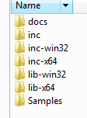
Setting up Plant SDK
Run the Plant 3D 2015 SDK Installer
http://images.autodesk.com/adsk/files/AutoCAD_Plant_3D_2015_SDK_English_Win_32_64Bit_dlm.sfx.exe
Plant SDK contains:
Documentation
Header files for C++
Static libraries for C++
.NET class libraries (DLLs)
Samples
Notes:
The Dev.Guide recommends to unpack to the ObjectARX folder
[Show the folders]

Slide 14
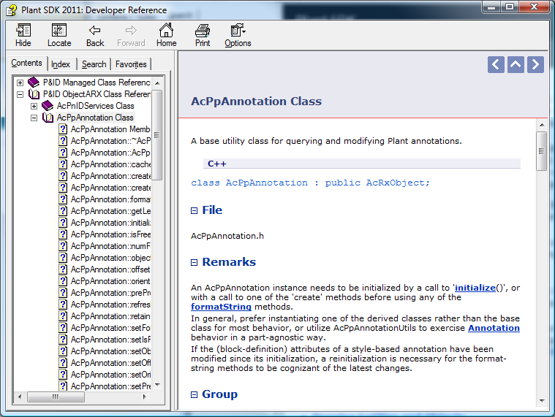
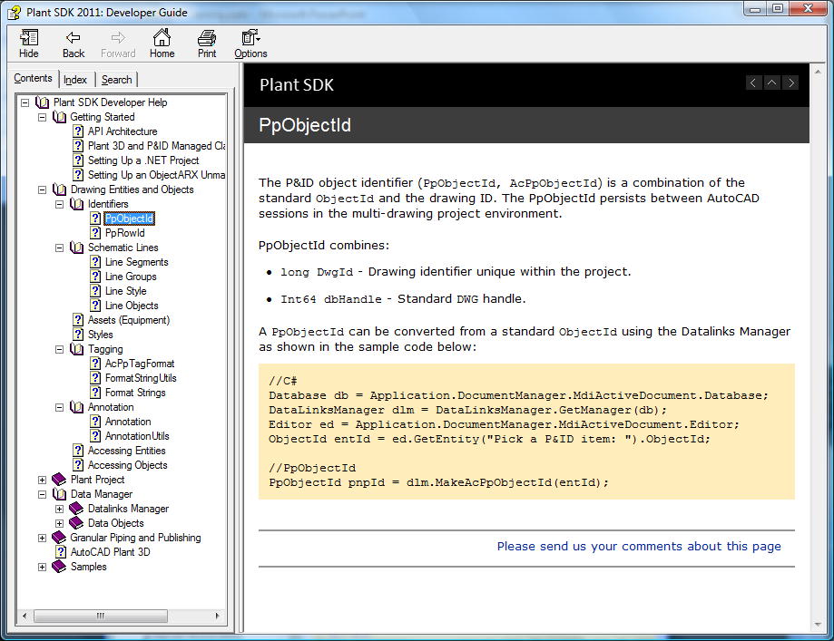
Plant SDK Documentation
PlantSDK\docs:
Plant SDK Developer Guide adskpid_dev.chm
Plant SDK Developer Reference adskpid_ref.chm
Notes:
Plant SDK Developer Guide not only teaches you how to create your add-ins, importantly it has many code snippets demonstrating usage of some of those APIs.
The Reference describes the classes and methods of the API.
Who drives the documentation? – You, partners! – Ask more from us.

Slide 15
Samples
C:\PlantSDK\Samples
PnPProp - .NET - DataLinksManager usage to display and update Data Manager properties
PnPScanValves – unmanaged C++ - Iteration through all of the schematic line segments in the drawing
ProjectList – unmanaged C++ accessing .NET ProjectManager
ListPipelineObjects - .NET – finds entities on a line
PipingValidation - .NET – validation of the project drawings
CreatePipeline - .NET – creates a simple pipeline
Knowledgebase on the ADN website
Notes:
[Show the folders]
PipingValidation does not seem to be working?
Knowledgebase – for ADN partners only

Slide 16
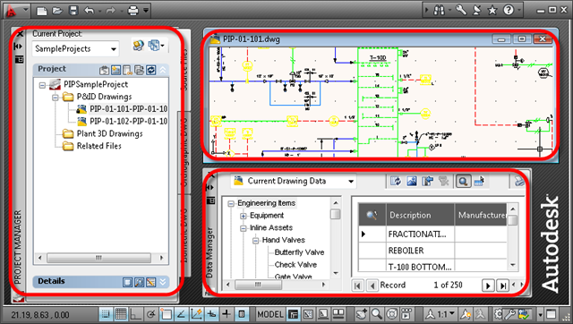
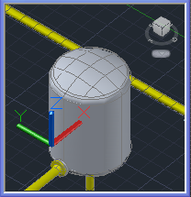
API Architecture
Drawing Entities and Objects. The schematic entities and supporting objects
Plant SDK API is organized into several main components:
Plant 3D Entities. Pipes, Vessels etc.
Project API. Used to control and define the Files and Settings that make up a Plant Project
Data API. Used to access and extend asset properties and project-wide link relationships

Slide 17
Plant SDK .NET Class Libraries
C:\Plant SDK\inc-win32 and inc-x64:
PnIDMgd.dll - P&ID Schematic entities and Utilities
PnPDataLinks.dll - Data links and Relationships
PnPDataObjects.dll - Project database
PnP3dObjectsMgd.dll - Piping 3D entities and Utilities
etc.
Refer to the Plant SDK Developer Reference to find, which class libraries you need for the classes you are using

Slide 18
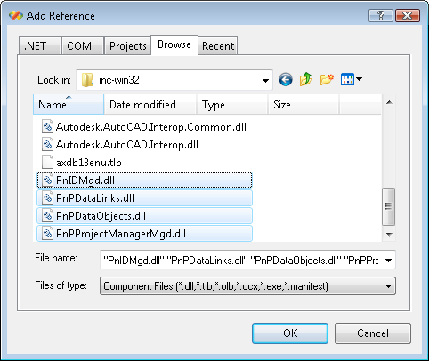
Referencing Class Libraries
Add references to the AutoCAD API class libraries:
acdbmgd.dll
acmgd.dll
Accoremgd.dll
Choose required Plant SDK libraries:
PnIDMgd.dll?
PnPDataLinks.dll?
etc.
Set the Copy Local property to False
Notes:
Browse to the ObjectARX directory and select the base libraries acdbmgd.dll, acmgd.dll.
Then Plant SDK directory (where you installed, can be the same as ObjectARX). Your .NET assembly can use classes defined in additional libraries.
To allow debugging and reduce the disk space requirements for your projects, select these libraries in the Visual Studio Solution Explorer, and set the Copy Local property to False.

Slide 19
Defining a Custom Command
Ready to create our first command:
Refer to the AutoCAD API documentation for details
[CommandMethod("HelloWorld")]
public void HelloWorld()
{
Application.DocumentManager.MdiActiveDocument.
Editor.WriteMessage("\nHello World!\n");
}

Slide 20
Lab 0 – Hello World in AutoCAD Plant 3D
Plant SDK setup
New Visual Studio project
Creating a command
Building the project
Debugging
Notes:
Is there anybody who already knows all this? If everybody knows, we can skip this.

Slide 21
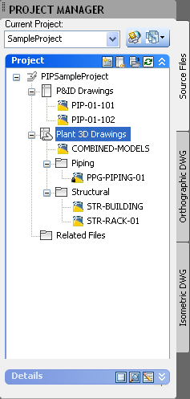
Project Hierarchy
We can analyze the structure of the project
For instance, we can find all the project drawings
The PlantApplication singleton represents the currently running Plant 3D application
It keeps a reference to the current project (an object of the PlantProject class)
PlantProject pp =
PlantApplication.CurrentProject;
Project prj = pp.ProjectParts["PnId"];
PnIdProject pnIdPrj = (PnIdProject)prj;

Slide 22
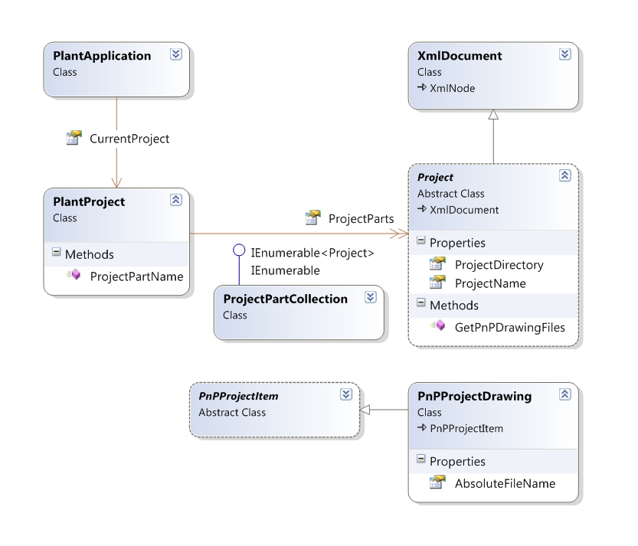
Project Hierarchy - Classes
PlantProject contains several projects like PnIdProject, PipingProject, IsoProject, OrthoProject
Each of these projects keeps a list of drawings (PnPProjectDrawing), specific settings etc.
Notes:
UML it's easy. Classes. Abstract classes. Inheritance. Methods, properties, relations.
Just a few classes, their methods and properties are shown here for clarity.
The PlantApplication has a property named CurrentProject which is a reference to a PlantProject instance.
It contains the ProjectParts property of the ProjectPartCollection type. Items in this collection are projects like PnIdProject etc. They have a common predecessor – the Project class. You can get the name, the directory etc. of the project and can get the list of drawings as well.

Slide 23
Lab 1 – Project Structure
Project Parts
Project Drawings
Project Settings

Slide 24
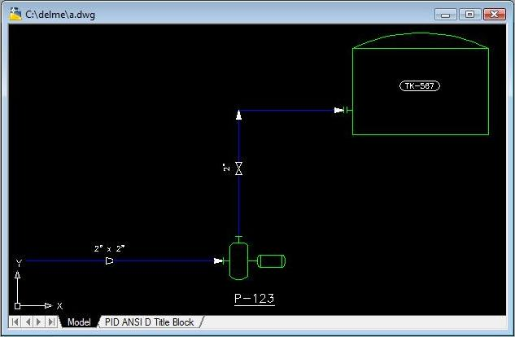
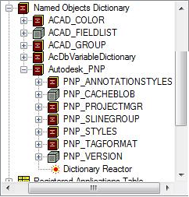
Drawing-resident Objects & Entities (P&ID)
Entities
Owned by a Model or Paper space
Lines (pipe & signal) - SLINE
Assets
Off-page connectors
Annotations
Objects
Autodesk_PNP root dictionary
Styles
Tag formats
Project
Notes:
As you, probably, know from the AutoCAD .NET API, the are always several blocks in the drawing: Model Space, Paper Spaces.
And P&ID entities are stored in these blocks.
Both entities and non-entities (and whatever else is saved to a dwg) are inherited from the DBObject class.
Use the API to access the Objects! Avoid directly accessing the dictionary.

Slide 25
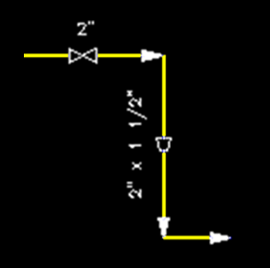
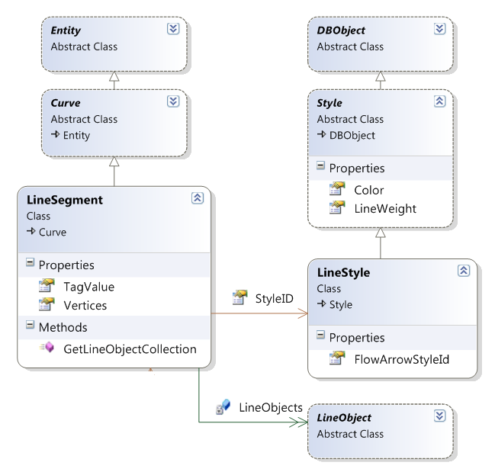
SLINE
Schematic line entities (SLINES) are represented by the LineSegment class
Signal lines
Pipelines
Appearance defined by an instance of LineStyle
Including a flow arrow style
Notes:
Lines are segmented by their functional connections.
LineSegments are similar to AutoCAD polylines, but have more features.

Slide 26
Styles
Project-centric Design
Define entities appearance (e.g. color, line type, block etc.)
projSymbolStyle.dwg (also known as "PSS.dwg")
Consistency across the project's drawings
Automatic propagation
Cached per drawing
PSS.dwg
Tank Style
Pump Style

Slide 27
Line Style
Is defined at the project level
Appearance changes made in one drawing propagate throughout the project
Can be accessed for a LineSegment via the StyleID property:
LineSegment sline = (LineSegment)tm.GetObject(
entId, OpenMode.ForRead);
LineStyle style = (LineStyle)tm.GetObject(
sline.StyleID, OpenMode.ForRead);
string sMsg = "\nStyle: " + style.Name;
Notes:
Name, Color etc.
More about Styles later

Slide 28
Line Group
The LineGroup class combines multiple LineSegments into a complete pipe or signal line
Similar to Groups in AutoCAD in behavior
Maintained automatically (not by the user)
Has a row in the project database (no AcDb representation)
Notes:
[Return to the diagram and show]

Slide 29
Accessing the Line Segments in a Line Group
The LineGroupManager.LineDbIds property contains Ids of all the segments
LineGroupManager lgmgr = new LineGroupManager();
int lgId = lgmgr.GroupId(sline.ObjectId);
foreach (ObjectId lsId in lgmgr.LineDbIds(lgId))
{
LineSegment ls = (LineSegment)tm.GetObject(
lsId, OpenMode.ForRead);
sMsg = ls.ClassName + ls.Vertices[0].ToString();
}

Slide 30
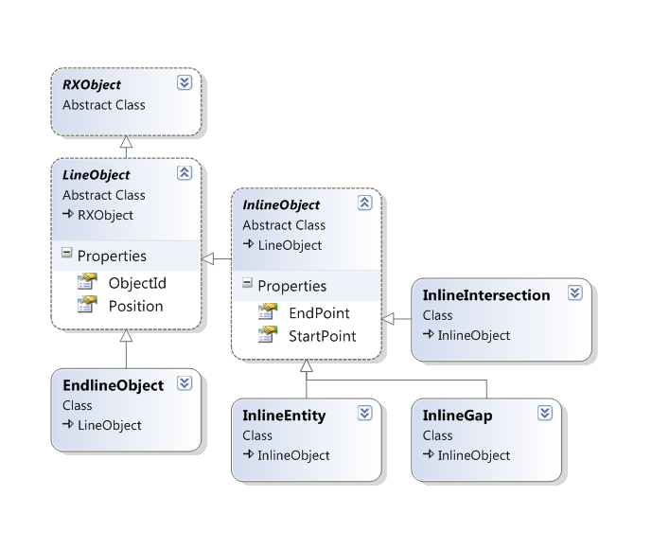
LineObject Class
A utility class used to identify sline segments, gaps, intersections, attached assets and connected SLINEs
Provides means to analyze sline connectivity
Can be used to modify line segments
For example, you can remove a gap:
LineSegment.RemoveLineObject( LineObject )
Notes:
Note that they all are not Entities and even not DBObjects.
LineObject and InlineObject classes are abstract
EndlineObject - Asset or segment at the Start or End of the line.
InlineEntity - All other assets or segments that are not Endline.
InlineGap - An explicit, manually created usergap.
InlineIntersection - Implied gaps, as from an intersection.

Slide 31
Iterating through the SLINE's LineObjects
LineSegment sline;
LineObjectCollection colLineObj = sline.GetLineObjectCollection(null);
foreach (LineObject lo in colLineObj)
{
Point3d pt = lo.Position;
if (lo is InlineEntity)
{
InlineEntity inlineEnt = (InlineEntity)lo;
Entity entityLo = (Entity)tm.GetObject(
inlineEnt.ObjectId, OpenMode.ForRead);
if (entityLo is Asset)
...
}
}
Notes:
Iterator is a “snapshot” of the line.
Valid while the owning line is open - ** Use quickly **.
Ordered from start to end.

Slide 32
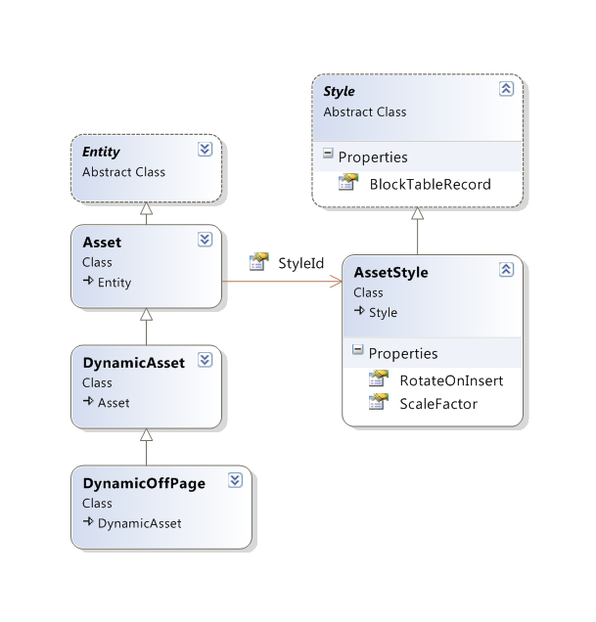
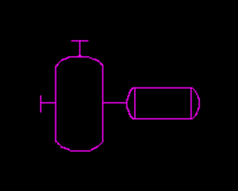
Asset Entity
Similar to a block reference
Appearance defined by an instance of AssetStyle
Indirect pointer to a block definition
Defines connection points
Tracks connections to lines and owned assets
Notes:
Pump and tank are of the same type – Asset, but of different style

Slide 33
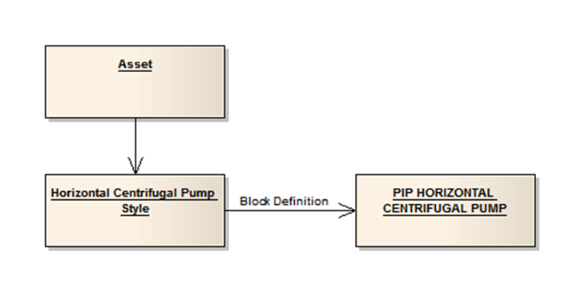
More About Assets
This is an illustration of the indirect block reference:
Flow arrow are assets too
Dynamic Asset
Based on dynamic blocks
Text evaluation
Dynamic Off-Page Connectors
Specialization for connecting lines
Notes:
This is another type of UML diagram – the Object Diagram. It's shown here that this particular asset refers to this particular style, which refers to a block definition.

Slide 34
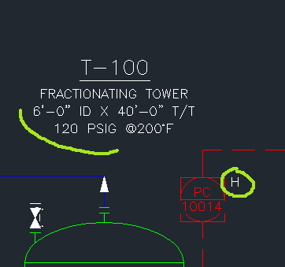
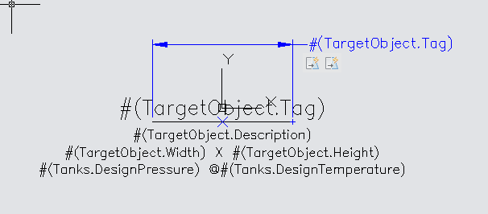
Annotation
Are not P&ID-specific entities
Linked to the annotated entity
Contain an PNP_ANNOTATION_DATA extension dictionary
Simple annotations
Just a Text entity
Format string
Complex
Dynamic Block reference
Format strings are the attribute definitions
Appearance controlled by an AnnotationStyle
Notes:
"H" here is a simple text.
Association to the annotated entity is maintained via a soft pointer.
Dynamic block parameters allow the annotation to be dynamically sized based on the evaluated size of the text

Slide 35
Annotation classes and templates
The Annotation class is a utility class used to create and maintain annotation entities
AnnotationStyle determines which block definition should be used upon annotation creation
projSymbolStyles.dwg stores dynamic block templates for annotations

Slide 36
Tags
AcPpTagFormat is a helper class used to store format strings that are assigned to an entity such as a simple annotation
When you copy a component or line, the new item is assigned a temporary tag that contains a question mark

Slide 37
Format Strings
Contain information about the project, drawing and item with which they are associated
#(Project.category.Property)
#(Drawing.category.Property)
#(class.Property)
Any name that appears within the parentheses is to be replaced with the respective value
Certain characters within the parentheses have special meaning, and cannot be part of a name
Examples:
#(CentrifugalPump.FlowRate)
#(TargetObject.Tag) - #(=TargetObject.Tag)
Notes:
Refer to the Developer's Guide [show this topic]

Slide 38
FormatStringUtils
Evaluates tag format strings into a string variable
isValid can be used to verify the format
In this example, the next LineNumber is returned and incremented
string sEval = FormatStringUtils.Evaluate(
"#(TargetObject.LineNumber^@NNN) - "
+ "#(Project.General.Project_Name)",
entId );
Notes:
…just as it would be if it was applied to an sline with an Autonumber tag

Slide 39
Lab 2 – SLINE objects

Slide 40
Identifiers - PpObjectId
Project1
2.dwg
drawingID=2
1.dwg
Handle=1
drawingID=1
Handle=1
Handle=2
Handle=2
PpObjectId = { drawingID=2; Handle=2 }
PpObjectId = { drawingID=1; Handle=2 }
Notes:
[animated]
Everything saved in a dwg has a Handle. When it's read into memory, the Handle is converted to an ObjectId.
But a project contains a number of drawings

Slide 41
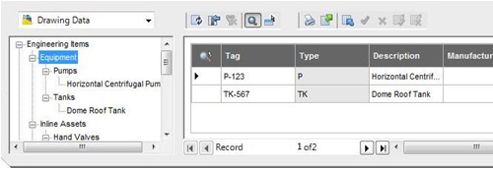
Identifiers – PnPID (PpRowId)
A database record is maintained for every logical item:
A single pipe or signal line can be represented by multiple LineSegments in multiple drawings. Each LineSegment has the same PpRowId, because it represents the same logical object.
PnPIDs are created for Line groups, Lines, Assets, Annotations etc.
Notes:
It's just a long

Slide 42
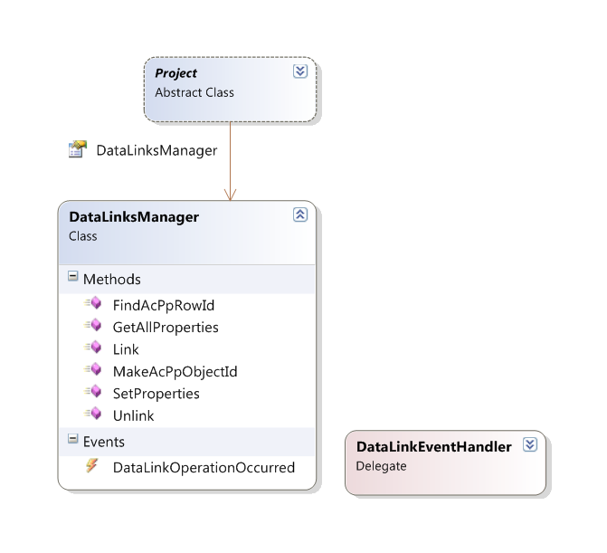
DataLinks Manager
Manages links between objects in AutoCAD drawings and non-graphical properties for the objects in the project database
Allows your program to react on some events
How to obtain it:
PlantProject mainPrj = PlantApplication.CurrentProject;
Project prj = mainPrj.ProjectParts["PnId"];
DataLinksManager dlm = prj.DataLinksManager;
Notes:
Obtain: Use the DLM property of the project

Slide 43
Reading and Writing Object Properties
List<KeyValuePair<string, string>> props =
dlm.GetAllProperties(objId, true);
foreach (KeyValuePair<string, string> pair
in props)
{
ed.WriteMessage("\n" + pair.Key
+ " : " + pair.Value);
}
...
dlm.SetProperties(rowId, strNames, strValues);
Notes:
strNames and strValues are of the StringCollection type

Slide 44
Conversions of Identifiers
ObjectId → PpObjectId (1 to 1)
ObjectId → PpRowId and PpObjectId → PpRowId (1 to 1)
PpRowId → PpObjectId's (1 to N)
DataLinksManager dlm;
ObjectId entId;
...
PpObjectId pnpId = dlm.MakeAcPpObjectId(entId);
int rowId1 = dlm.FindAcPpRowId(entId);
int rowId2 = dlm.FindAcPpRowId(pnpId);
PpObjectIdArray ids =dlm.FindAcPpObjectIds(rowId);
Notes:
-> PpRowId: You can use ObjectId or PpObjectId
PpRowId -> NOTE: It returns a COLLECTION of AcPpObjectId! I.e., multiple ObjectIds may be linked to a single RowID

Slide 45
Inter-object Relationships
Non-visible relationship data
Predefined set
Definition:
Type
Roles
Row Id to Row Id
Example:
Type
AssetOwnership
Role 1
Owner (tank)
Role 2
Owned (nozzle)
dlm.Relate("AssetOwnership", "Owner", entId1, "Owned", entId2);
Notes:
We use the Datalinks Manager, again

Slide 46
Predefined Relationships
Relationships
LineInlineAsset
LineStartAsset
LineEndAsset
LineFlowArrow
AnnotationRelationship
AssetOwnership
SegmentBreak
LineOffPageConnector
LineNozzle
PipeLineGroupRelationship
SignalLineGroupRelationship
ConnectorsRelationship
AssetNonEngineeringRelationship
Roles
Line
Asset
Arrow
Annotated
Annotation
Owner
Owned
Break
OffPageConnector
Nozzle
PipeLineGroup
SignalLineGroup
PipeLine
SignalLine
Connector1
Connector2
NonEngineering
Notes:
Just for your information

Slide 47

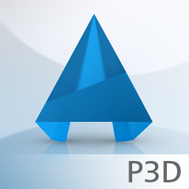
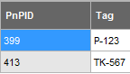
Data structure
AutoCAD APIs
Transaction
ObjectId
Plant 3D APIs
ObjectId
PpObjectId
RowId
PnPDataObjects
Row Id
Independent
Notes:
Let’s try understand the data structure with the layers.
First we have the AutoCAD APIs with its transaction and the object IDs of each graphical entity. Second there is a Plant 3D layer, which also have have ObjectID, but also PpObjectId and RowId. This basically play as a connection to the next layer, the PnPDataObjects with the same Row Id. One interesting point: this PnPDataObjects is available outside AutoCAD, meaning it can run as a out-of-process library.
In fact these layers can transfer and communicate with each other.

Slide 48
Project Database APIs
DataLinks Manager
Pros
High level and easy to use
Access from native code and .NET
Cons
Inefficient in some cases
Name ←→ value pairs (strings)
PnPDataObjects
Pros
Efficient access to tables, columns, and rows
ADO.NET usage model
Usable outside of AutoCAD
Can modify the schema
Cons
Access from .NET only
Lower level API
Risky

Slide 49
Lab 3 – Data Manager

Slide 50
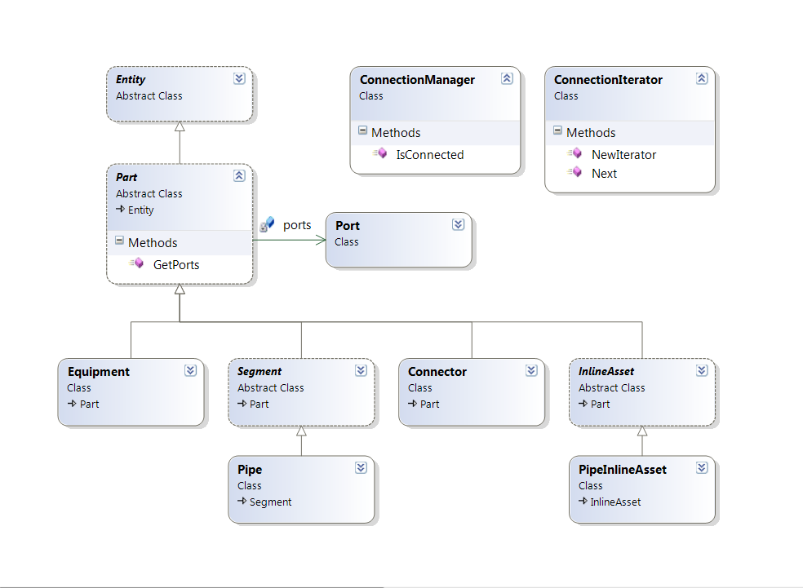
Plant 3D Class Hierarchy

Slide 51
Plant 3D Support Classes
DataLinksManager3d
Encapsulated DataLinksManager (not inheritance)
LineGroups
SpecManager
SpecPart
Content Manager
Used to acquire graphical representations
Content adapters
Dynamic (Python scripts), Static blocks
PipingObjectAdder (NEW for 2013)
ConnectionManager

Slide 52
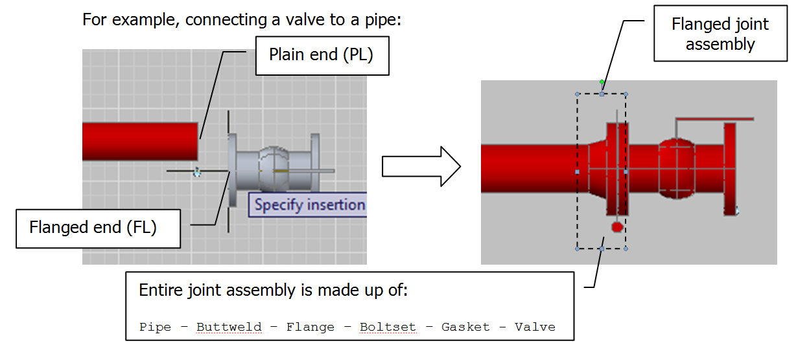
Connections
All connections are in the form of:
Part (Port) – (Port) Connector (Port) – (Port) Part
Simple joints, complex joints (adapter needed)

Slide 53
Iterating Pipes
PortCollection portCol =part.GetPorts(PortType.All);
ConnectionManager conMgr = new ConnectionManager();
foreach (Port pPort in portCol)
{
Pair pair1 = new Pair();
pair1.ObjectId = entId;
pair1.Port = pPort;
if (conMgr.IsConnected(pair1))
{
ConnectionIterator connectIter = ConnectionIterator.NewIterator(pPart.ObjectId);
for (; !connectIter.Done(); connectIter.Next())
{
ObjectId curObjId = connectIter.ObjectId;
...

Slide 54
Plant 3D Content Data Flow
Piping
Catalog(s)
Piping
Specification
e.g. Welds
Equipment
Catalog
Project Model
Non-Spec Part
Notes:
Catalogs contain available content across projects.
Specs are project specific and contain a subset of the content (i.e. subset of catalog). “Spec driven piping design.”
Parts are placed into project from specs.
Equipment and non-spec parts are “special” and do not come in from specs.

Slide 55
Adding a Pipe Fitting
Spec
ContentManager
SpecPart
Block
PipeInlineAsset
Project
Database
AcDbDatabase

Slide 56
Inserting Pipe Fitting
var specMgr = SpecManager.GetSpecManager();
SpecPart part = null;
var reader = specMgr.SelectParts(“CS300”, “Valve”,
names, values);
for (; !reader.Done; reader.Next) {
part = reader.Current;
break;
}
var contentMgr = ContentManager.GetContentManager();
var blockId = content.GetSymbol(part, db);
var asset = new PipeInlineAsset();
asset.SymbolId = blockId;
asset.Position = pos;
asset.SetOrientation(xAxis, zAxis);
var adder = new PipingObjectAdder(dlm, db);
adder.Add(part, asset);
reader.Dispose();

Slide 57
Lab 4 – Pipes

Slide 58
Lab 5 – Database Events

Slide 59
Data Objects
Using PnPDataObjects, we may extend non-graphical properties in the Data Manager
PnPDatabase, PnPTable and PnPColumn classes
PnPDbEngine provides services for reading and writing data objects. In addition to the default implementation, PnPMsSQLDbEngine and PnPJetDbEngine are available

Slide 60
External Data Sources
External Data Source Models
Uses OLEDB ADO.NET provider for data source
Foreign key to Primary key mapping
Property Source Model
Fill column(s) in project database
Extension Properties Model
Add new columns dynamically to project database

Slide 61
Lab 6 – Working With The Database

Slide 62
Autodesk Exchange Store

Slide 63
Preparing your app
Pack as .bundle
Use the provided template to start
Create a help file
Can be .HTML
Create a CUIx for your app
Submit for review

Slide 64
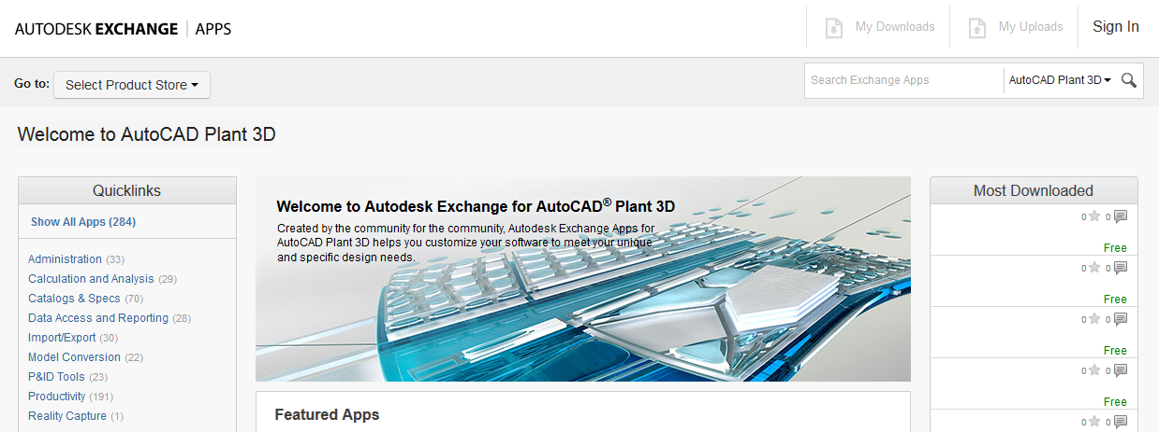
Demonstration
https://apps.exchange.autodesk.com

Slide 65
Thank you!

